Slide 1
Recap

Slide 2
What is a model?
The traditional programming
House Surface = 100 sqm
Data
Computer
Price = 500 000 Pounds
Output
5000 x House Surface = Price
Program
Machine Learning
Data
House Surface = 100 sqm
Computer
5000 x House Surface = Price
Program
Price = 500 000 Pounds
Output

Slide 3
What is a model?
Machine Learning
is a field devoted to building methods/algorithms that
learn based on the data and
return a program/model
that will automatise and improve performance on some tasks.

Slide 4
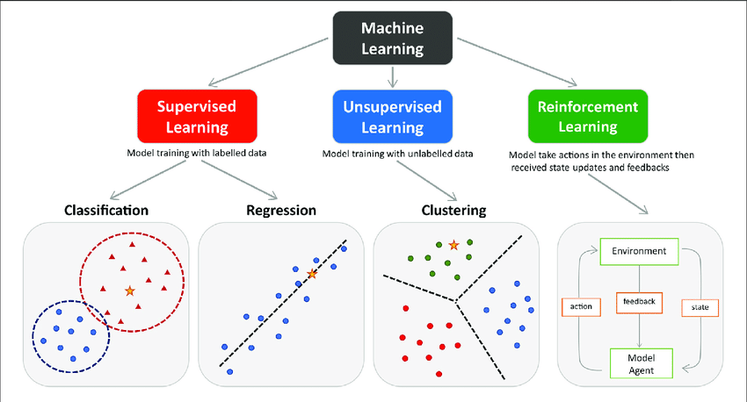
Types of learning

Slide 5
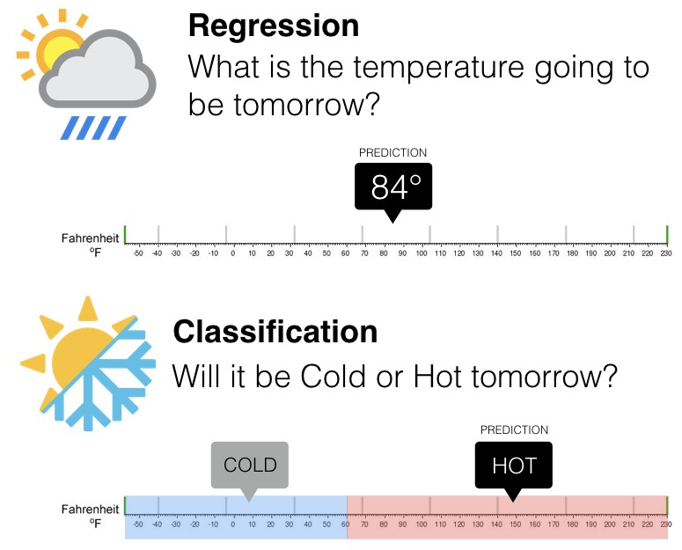
Types of problems
Regression means to predict an output value which should be a real number.
Classification means to predict an output value which should be a category.

Slide 6
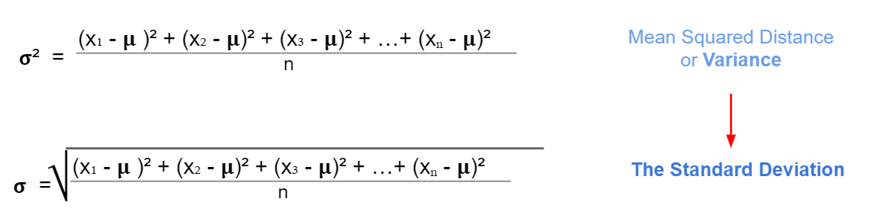
Standard Deviation

Slide 7
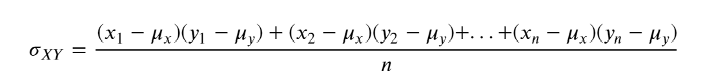
Covariance and Correlation
Covariance is a measure of two joint variable variances. Suppose the greater values of one variable mainly correspond with the greater values of the other variable, and the same is for the lesser values. In that case, these variables tend to show similar behaviour. Thus, we will say that our covariance is positive.

Slide 8
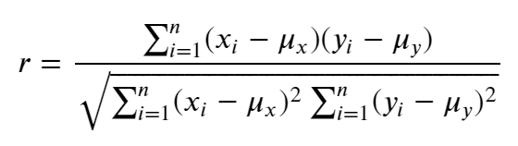
Covariance and Correlation
Covariance ranges between negative and positive infinity, and it only tells us when two variables are inversely or positively related. But it isn't easy to know if a relationship between two variables is stronger than the relationship between other pairs of variables. This is where the concept of correlation comes in.
Correlation is calculated by standardizing covariance by some measure of variability in the data. It produces a quantity that has intuitive interpretations and a consistent scale.
There a lot of correlation coefficients, but for now, we will focus on Pearson correlation.

Slide 9
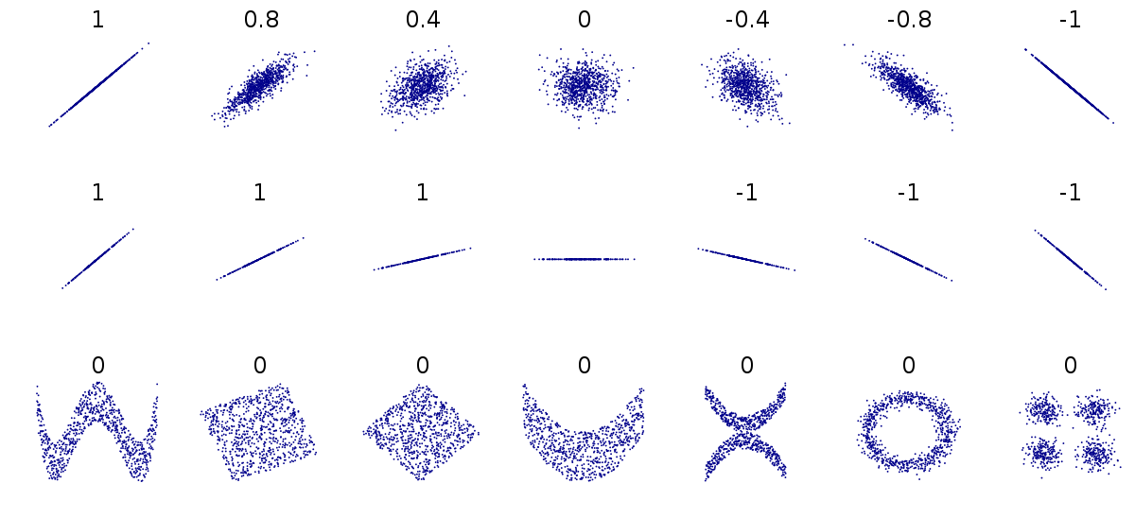
Covariance and Correlation
Linear and non-linear relationships

Slide 10
Covariance and Correlation
Correlation is not causation
Causation is when any change in the value of one variable leads to a change in the value of another variable, which means one variable causes the change in another, in other words they have a cause-effect relationship.
Check this website for some insane correlations: https://www.tylervigen.com/spurious-correlations
So we can draw conclusion based just on correlation, this should be just the first step. We should take time to find other underlying factors, verify if they are correct and then conclude.

Slide 11
Session 03.01
Linear Regression intro.
Level 7 – AI data specialist
3 - Building Machine Learning Models and Data Preprocessing Techniques
Inesa Lisnic
i.lisnic@learn-tech.com
07432137361

Slide 12
KSBs
K1: How to use AI and machine learning methodologies such as data-mining, supervised/unsupervised machine learning, natural language processing, machine vision to meet business objectives
K19: The principles and properties behind statistical and machine learning methods
K23: The use of different performance and accuracy metrics for model validation in AI projects
S2: Independently analyse test data, interpret results and evaluate the suitability of proposed solutions, considering current and future business requirements

Slide 13
P17
P17: Pass criterion: Describes how to use statistical, AI and machine learning methodologies such as data- mining, supervised/unsupervised machine learning, natural language processing and machine vision to meet business objectives.
This assessment criterion requires the apprentice to demonstrate their understanding and application of various statistical, AI, and machine learning methodologies to achieve business objectives, examples may include:
Key Methodologies
1. Statistical Methods:
Descriptive Statistics
Inferential Statistics
2. Data Mining:
Purpose: Discover patterns and relationships in large datasets.
Techniques: Clustering, association rule mining, and anomaly detection.
Application.
3. Supervised Machine Learning:
Purpose: Train models on labelled data to make predictions or classifications.
Techniques: Linear regression, logistic regression, decision trees, random forests,
and support vector machines.
Application.
4. Unsupervised Machine Learning:
Purpose: Find hidden patterns or intrinsic structures in unlabelled data.
Techniques: K-means clustering, hierarchical clustering, and principal component
analysis (PCA).
Application
5. Natural Language Processing (NLP):
Purpose: Enable machines to understand and interpret human language.
Techniques: Tokenisation, sentiment analysis, named entity recognition (NER), and
topic modelling.
Application.
6. Machine Vision:
Purpose: Enable machines to interpret and understand visual information.
Techniques: Image classification, object detection, and image segmentation.
Application.
Meeting Business Objectives, such as:
1. Improving Customer Retention
2. Enhancing Customer Experience
3. Optimising Operations
4. Increasing Sales and Marketing Effectiveness
5. Fraud Detection

Slide 14
P19
P19: Pass criterion: Describes the relationship between mathematical principles and core techniques in AI and data science within the organisational context.
Clarification: This assessment criterion requires the apprentice to explain how they use mathematical principles to underpin and explain the core techniques, their use of AI and data science, and how these techniques are relevant to the context of their organisation.
This could include:
Mathematical Principles
Linear Algebra:
Vectors and Matrices: Fundamental for representing data and operations in machine learning algorithms. Used in techniques like Principal Component Analysis (PCA) for dimensionality reduction.
Matrix Decompositions: Techniques such as Singular Value Decomposition (SVD) are used in recommendation systems and image compression.
Calculus:
Differentiation and Integration: Essential for understanding and optimising machine learning models. Gradient descent, a key optimisation algorithm, relies on calculus to minimise the loss function.
Partial Derivatives: Used in back propagation for training neural networks.
Probability and Statistics:
Probability Distributions: Used to model uncertainties and make predictions.
Techniques like Bayesian inference rely on probability theory.
Statistical Methods: Hypothesis testing, confidence intervals, and regression analysis are used to infer patterns and relationships in data.
Optimisation:
Convex Optimisation: Many machine learning algorithms, such as support vector machines (SVMs), rely on convex optimisation techniques to find the best parameters.
Stochastic Optimisation: Methods like stochastic gradient descent (SGD) are used to handle large datasets efficiently.
Core Techniques in AI and Data Science
Supervised Learning:
Regression and Classification: Techniques like linear regression, logistic regression, decision trees, random forests, and support vector machines are used to predict outcomes based on labelled data.
Neural Networks: Deep learning models that use multiple layers to learn complex patterns in data.
Unsupervised Learning:
Clustering: Techniques like K-means and hierarchical clustering are used to group similar data points.
Dimensionality Reduction: Methods like PCA and t-SNE reduce the number of features while preserving important information.
Natural Language Processing (NLP):
Text Analysis: Techniques like tokenisation, sentiment analysis, and named entity recognition (NER) are used to process and analyse textual data.
Language Models: Models like BERT and GPT are used for tasks such as text generation and translation.
Machine Vision:
Image Processing: Techniques like convolutional neural networks (CNNs) are used for image classification, object detection, and segmentation.
Application in Organisational Context
Business Decision-Making:
Predictive Analytics: Using regression models and neural networks to forecast sales, customer behaviour, and market trends.
Risk Management: Applying statistical methods and machine learning to identify and mitigate risks.
Operational Efficiency:
Process Automation: Implementing AI-driven automation for repetitive tasks, such as data entry and customer service.
Quality Control: Using machine vision to detect defects in manufacturing processes.
Customer Insights:
Segmentation and Targeting: Using clustering techniques to segment customers and tailor marketing strategies.
Sentiment Analysis: Applying NLP to analyse customer feedback and improve products and services.
Innovation and Development:
Product Development: Leveraging AI to design and test new products, such as using generative models for design optimisation.
Research and Development: Using data mining and machine learning to discover new insights and drive innovation.

Slide 15
D09
D9: Distinction criterion: Explains when they have challenged the norm through investigating and proposing a solution and the impact this had.
Clarification: This distinction level assessment criterion is asking the apprentice to demonstrate their ability to think critically and innovate by challenging established practices or norms.
Challenging the Norm: Describe a situation where they identified an existing practice, process, or belief that they felt needed improvement or change. This could be in any context, such as a business process, a technical approach, or a team dynamic.
Investigating: Explain how they conducted research or gathered data to understand the issue better. This might involve analysing data, consulting with experts, or reviewing relevant literature. The goal is to show that their challenge was based on informed insights rather than assumptions.
Proposing a Solution: Detail the solution they proposed to address the issue. Highlight the innovative aspects of their solution and how it differed from the existing norm. This could include new methodologies, technologies, or strategies.
Impact: Discuss the impact of their proposed solution. This could involve improvements in efficiency, cost savings, enhanced performance, or other measurable benefits. Be specific about the positive outcomes and how they validated their approach.

Slide 16
Today’s Objectives
Understand and follow the ML model design workflow for supervised learning
Understand the linear function
Know how to create a linear model with scikit-learn library
Know how to predict with a model the target values for new instances
Know how to evaluate the model performance

Slide 17
ML model design workflow

Slide 18
ML model design workflow for supervised learning
9. Split data into train and test dataset
10. Build and train the model on the train dataset
6. Perform the Exploratory Data Analysis
7. Define the target
1. Understand the business problem
11. Evaluate the model on the test dataset
8. Select the features
5. Perform data cleaning
2. Understand the data and decide the tools and methods to use
13.Feature engineering
12. Validate the model
4. Perform an initial investigation of the data
Check the model assumptions (if any)
3. Extract the data
14. Interpret the results

Slide 19
Introduction to Linear Regression

Slide 20
Introduction to Linear Regression
Linear regression was developed in the field of statistics and is studied as a model for understanding the relationship between input and output that are numerical variables.
This model has been borrowed by machine learning for predicting the output.

Slide 21
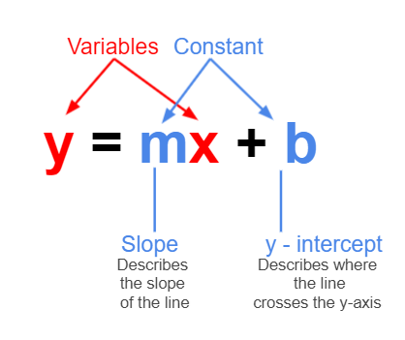
Introduction to Linear Regression
target
parameter

Slide 22
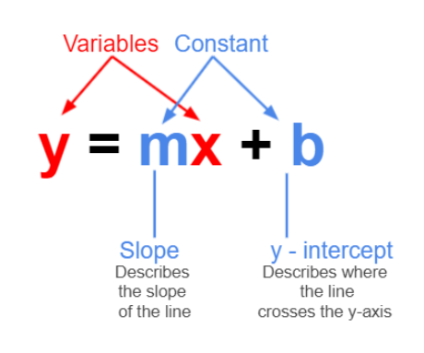
Variables and constants

Slide 23
Simple Linear Regression vs Multiple Linear Regression

Slide 24
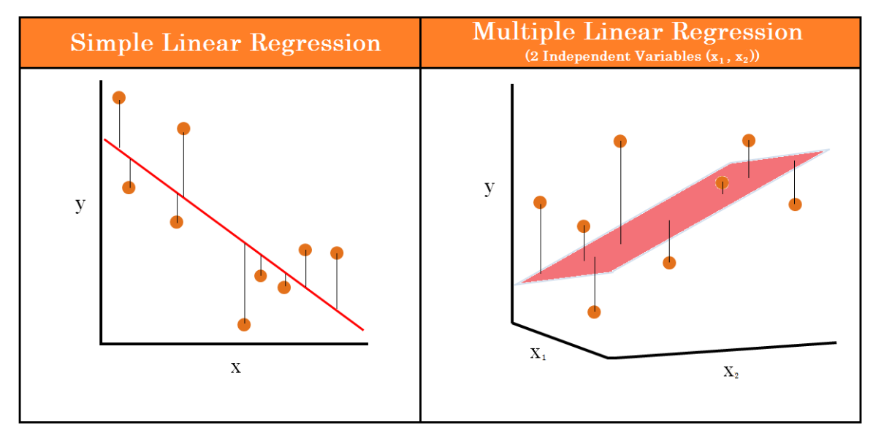
Simple vs Multiple LR
https://www.keboola.com/blog/linear-regression-machine-learning

Slide 25
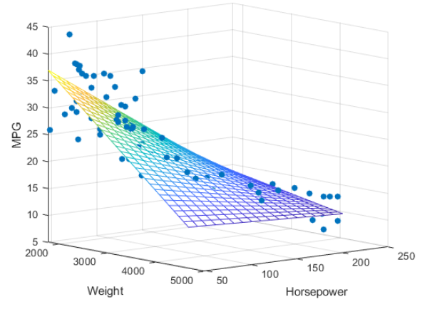
Multiple LR

Slide 26
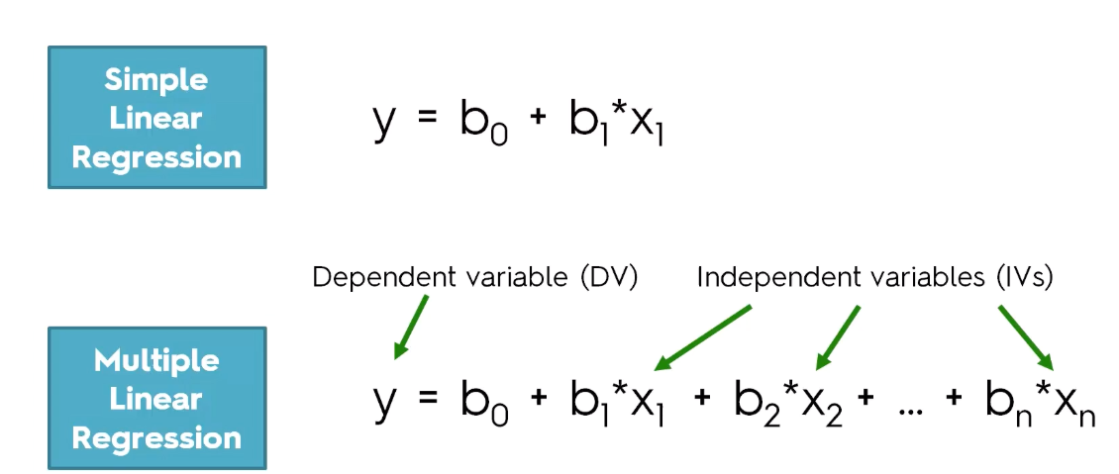
Simple vs Multiple LR
https://www.digitalvidya.com/blog/regression-analysis/

Slide 27
Train-test split

Slide 28
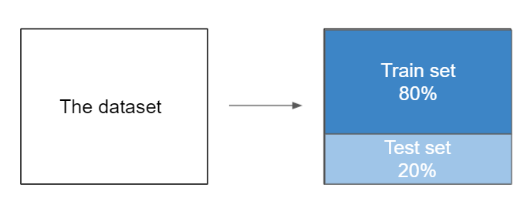
Train-test split
We can test the quality of our model by splitting it into 2 parts:
the training set: contains the main part of the data (80%)
the test set: contains the rest of the data from the whole (20%)
The train set is used to train the model - this means finding the model that best approximates the training set. This is the most computationally intensive process.
The test set is used to predict the values - predict the target value for an instance by plugging features into the trained model. This process is computationally cheap.
Then we can compare the train and test score.

Slide 29
Train-test split
from sklearn.model_selection import train_test_split
Import the function train_test_split from the sklearn library. This function helps us randomly dividing the data into 2 sets: train and test
X_train, X_test, y_train, y_test = train_test_split(X, y, test_size=0.20, random_state=42)

Slide 30
Model creation

Slide 31
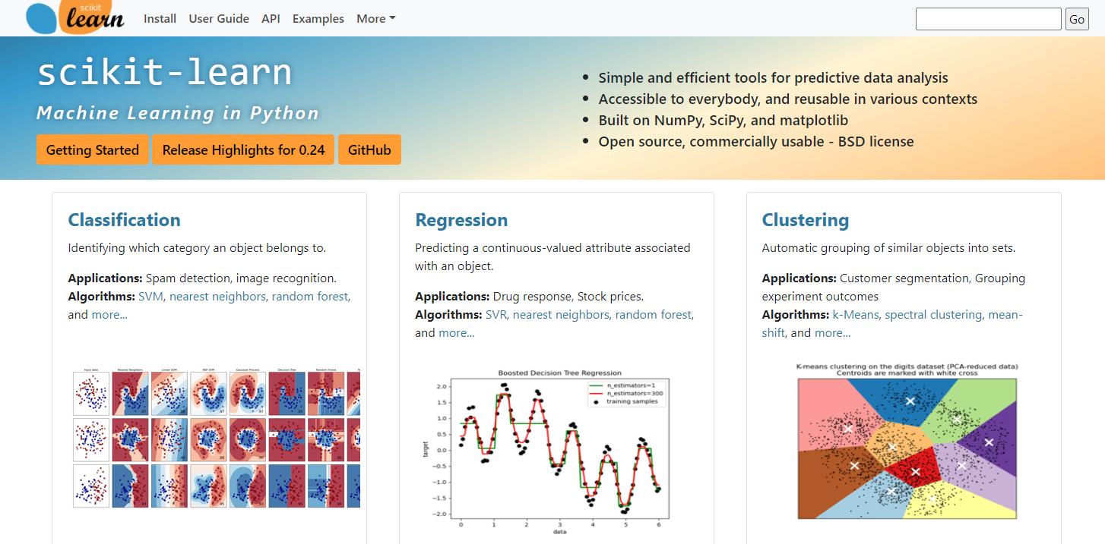
Model creation
https://scikit-learn.org/stable/

Slide 32
Model creation
- Import the class LinearRegression from the sklearn library
from sklearn.linear_model import LinearRegression
- Create a Linear Regression Model
model = LinearRegression()
- Fit the data into the model (this step is also described as the model training). At this stage the model estimate the best slope and intercept of the function.
model = model.fit(X_train, y_train)
model.coef_
model.intercept_
- After training the model we can get the slope(coef) and the intercept

Slide 33
Model evaluation

Slide 34
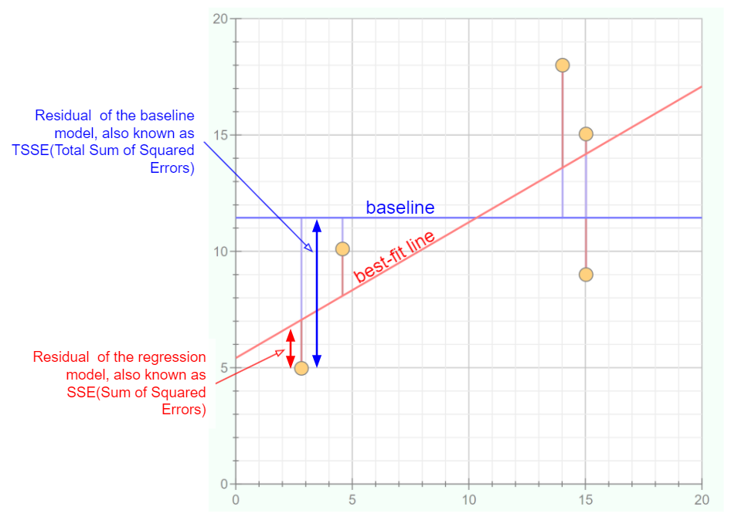
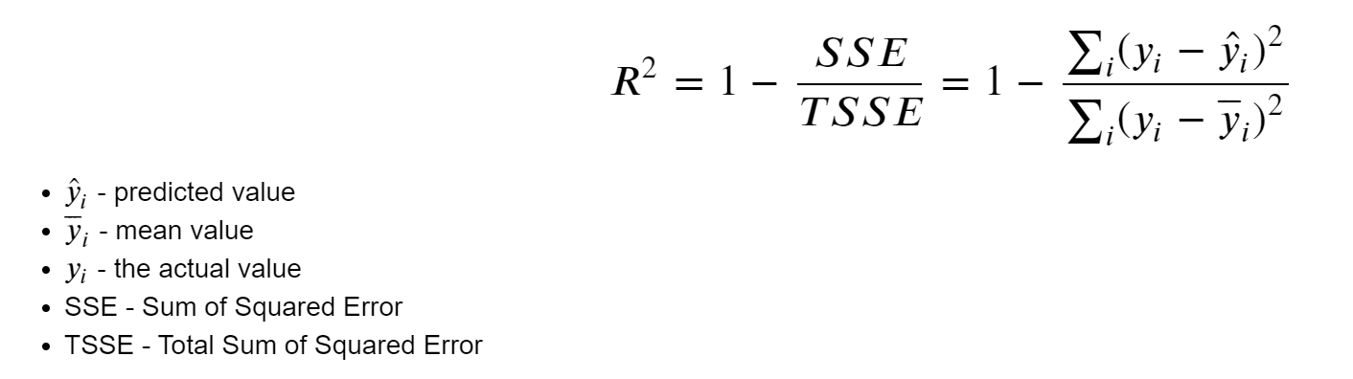
Model evaluation
The coefficient of determination(R-squared)
model.score(X_train, y_train)
- We can get the coefficient of determination which shows how much data can be explained by the model.

Slide 35
R squared
R squared ranges from 0 to 1.
If R squared = 1: Our model perfectly predicts the data. Every observed value matches the model's prediction.
If R squared = 0: Our model is no better than simply predicting the mean for every data point.

Slide 36
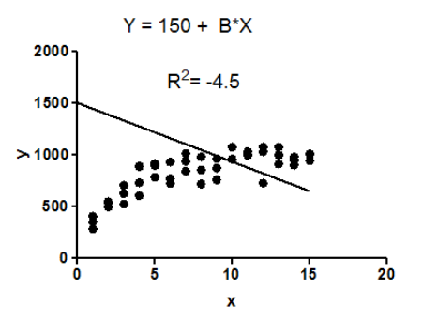
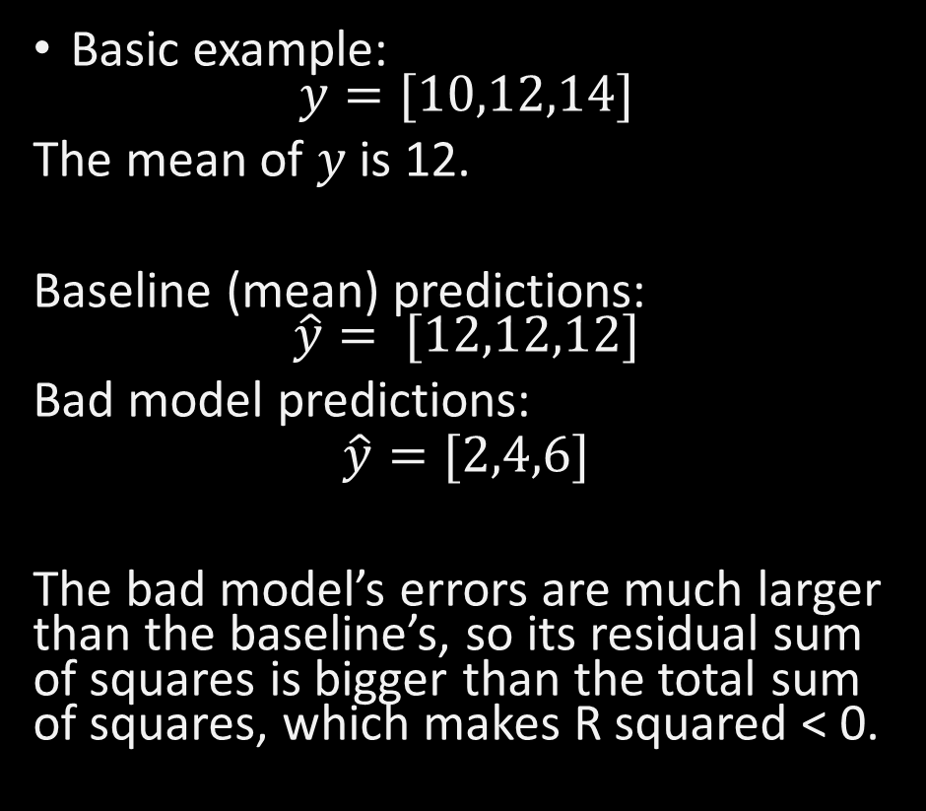
Negative R squared
Basic example:
$$y=[10,12,14]$$
The mean of $y$ is 12.
Baseline (mean) predictions:
$$\hat{y}= [12,12,12]$$
Bad model predictions:
$$\hat{y}=[2,4,6]$$
The bad model’s errors are much larger than the baseline’s, so its residual sum of squares is bigger than the total sum of squares, which makes R squared < 0.
https://stats.stackexchange.com/questions/12900/when-is-r-squared-negative

Slide 37
Model evaluation
The errors
Besides the score(coefficient of determination) we have another metric based on the model errors.
The error metric quantifies how inaccurate our predictions were compared to the actual values.
We can compute it by calculating the difference between each predicted and actual value and then averaging these differences.

Slide 38
Model evaluation
MAE – the mean of the absolute errors
MSE – the mean of squared errors
A low error metric means that the gap between the predicted list revenue and actual revenue values is low while a high error metric means the gap is high.
RMSE - the square root of the mean squared errors
from sklearn.metrics import mean_absolute_error
mean_absolute_error(y_test, y_predicted)
from sklearn.metrics import mean_squared_error
mean_squared_error(y_test, y_predicted)
mean_squared_error(y_test, y_predicted, squared = False)

Slide 39
Model evaluation
MAE vs RMSE
both MAE and RMSE express average model prediction error in units of the variable of interest
both of them range between 0 and +infinite
both of them are negatively-oriented scores, which means lower values are better
BUT
RMSE gives a relatively high weight to large errors. This means RMSE might be more useful when large errors are undesirable.

Slide 40
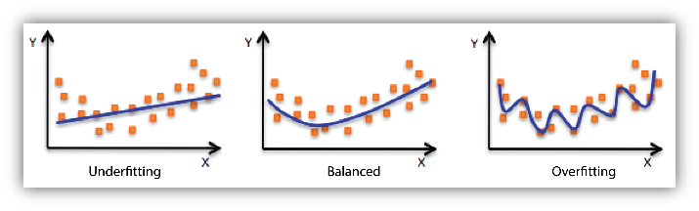
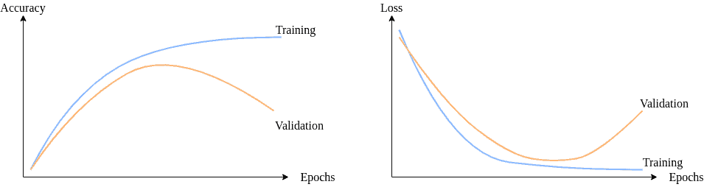
Underfitting vs overfitting
Underfitting and Overfitting
Another reason to use a train-test split data is the underfitting and overfitting. An overfit model is a too good trained model. This model contains a risk of not generalizing well when predicting new data. An underfit model is not well trained, and it will produce weak predictions as well.
https://www.baeldung.com/cs/ml-underfitting-overfitting

Slide 41
Model validation

Slide 42
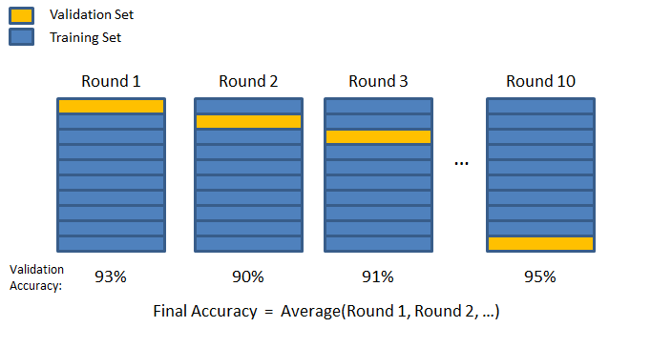
Model validation
Model performance evaluation: cross validation
Due to the randomness, different samples can have different scores. In order to get a more general value of the score we can perform the K-fold Cross Validation.
https://chrisjmccormick.wordpress.com/2013/07/31/k-fold-cross-validation-with-matlab-code/

Slide 43
Model validation
Model performance evaluation: cross validation
from sklearn.model_selection import cross_val_score
- Import the function cross_val_score from the sklearn library. This function helps us dividing the data in a number of partitions. Then it will train and test the same number of the models as partitions we have.
scores = cross_val_score(model, X, y, cv=5, scoring = 'r2')
Number of
partitions
We need to chose the evaluation metric

Slide 44
Recap and OTJ activities

Slide 45
Recap of today’s objectives
Explain the Machine Learning concept
Recognise different types of learnings
Understand the linear function
Know how to create a linear model with scikit-learn library
Know how to predict with a model the target values for new instances
Know how to evaluate the model performance
Know how to validate a model

Slide 46
OTJ Activities
Predict the house prices
- Use the Seattle houses data to build a regression model. The model has to be able to predict the prices of the new houses. Check all requirements from the given Jupyter Notebook.

Slide 47
Next week…
LR - assumptions

